Slide 1

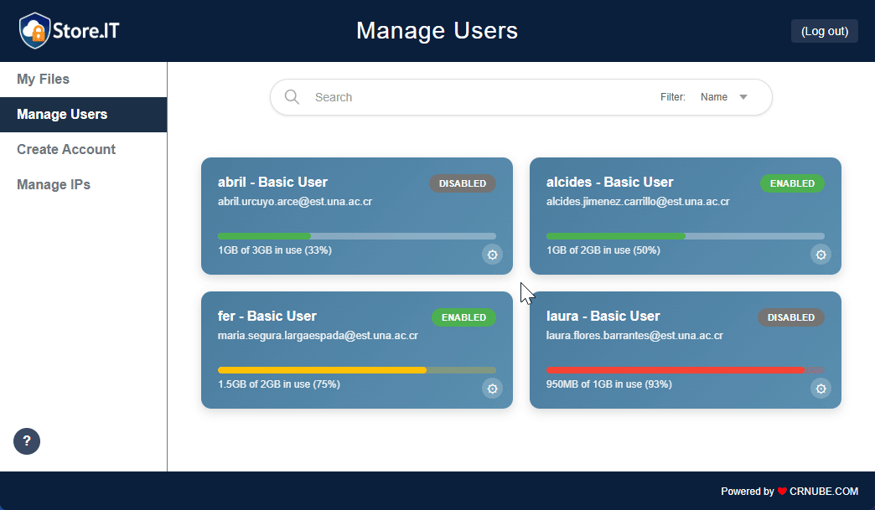

User Account Creation
and Activation Manual

Slide 2
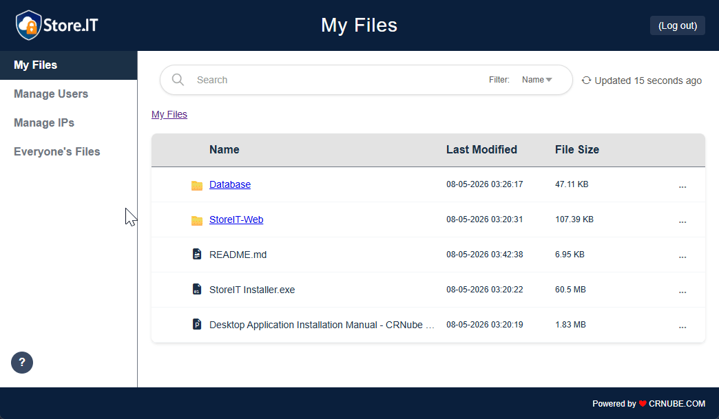
Step #1
From the StoreIT Web home screen, navigate to Manage Users using the sidebar. Then, click on Create Account to access that tab. Note that you must be a Superadministrator or Administrator to access these modules.

Slide 3
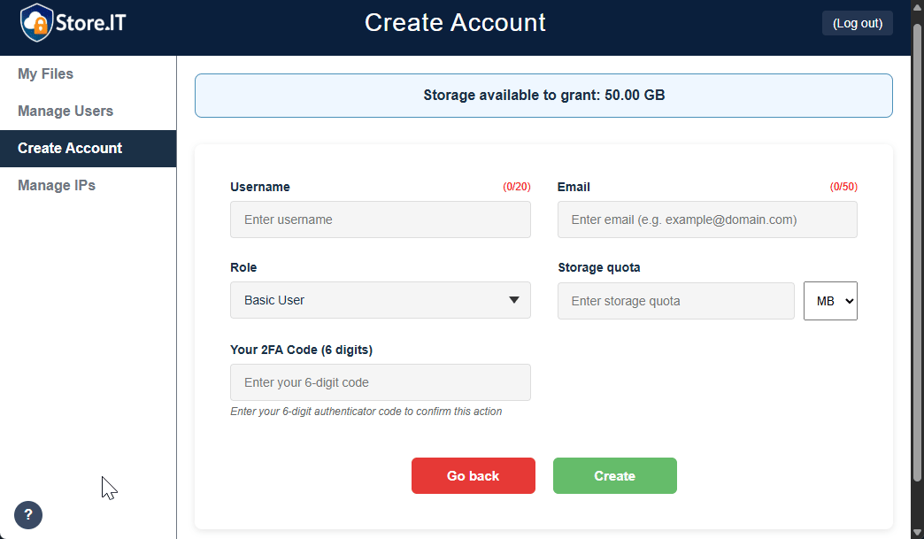
Step #2
Enter the new user's username and email address, then choose their role and the storage quota you wish to grant them. Note that this quota will be deducted from the Superadministrator's available quota, which is displayed at the top of the screen.

Slide 4
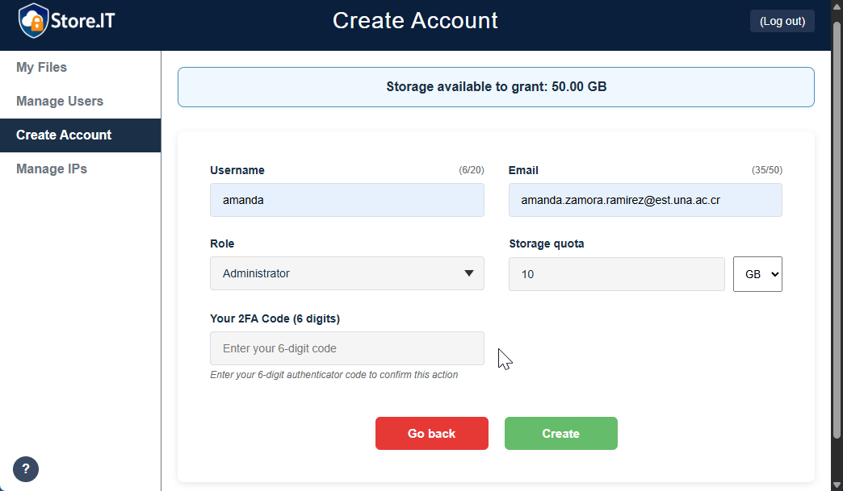
Step #3
Now, go to the multi-factor authentication app you used when you set up 2FA on your first login. Enter the code corresponding to your StoreIT account and click Create. At this moment, you should now see a success message indicating that an account activation email has been sent to the new user.

Slide 5
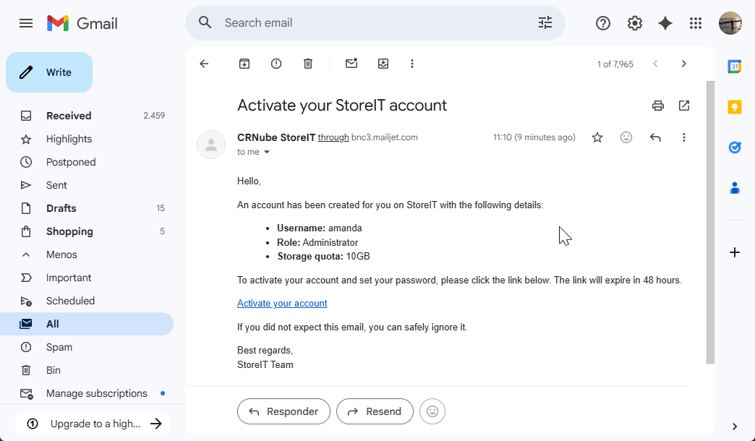
Step #4
Now, the owner of the newly created account should check their inbox and open the received email related to account creation. In it, along with other information, they will find a link to activate the account. Please note that the link expires after 48 hours; after this time, the account will be deleted.

Slide 6
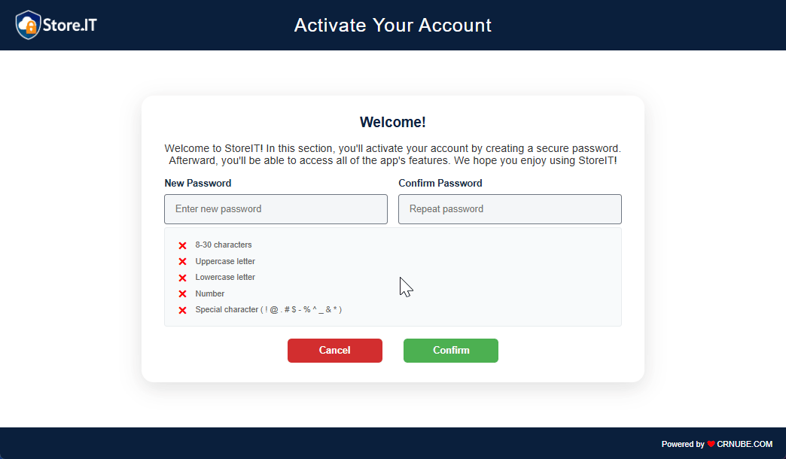
Step #5
To activate the account, the new user must create a password, respecting the indicated security restrictions. Once this is done, they must click Confirm. This will redirect them to the login page, where they will see a confirmation message indicating that the account has been activated. From there, they can log in and explore all the features that StoreIT offers for their role.

Slide 7
Congratulations, you have successfully completed the account creation and activation process!
We hope you enjoy the app. Consult the other application manuals and/or the README.md files available in the respective repositories for more information.

